Slide 1
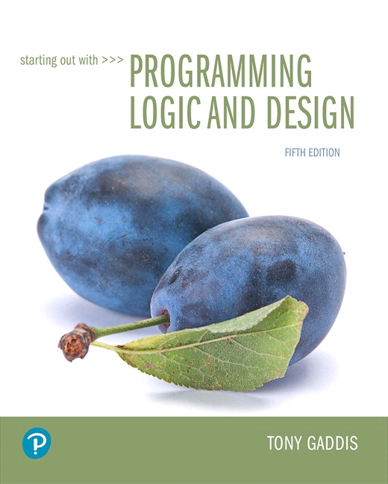
Starting out with Programming Logic and Design
Fifth Edition
Chapter 2
Input, Processing, and Output
Copyright © 2016, 2013, 2010 Pearson Education, Inc. All Rights Reserved
Notes:
If this PowerPoint presentation contains mathematical equations, you may need to check that your computer has the following installed:
1) MathType Plugin
2) Math Player (free versions available)
3) NVDA Reader (free versions available)

Slide 2
Learning Objectives
2.1 Designing a Program
2.2 Output, Input, and Variables
2.3 Variable Assignment and Calculations
2.4 Variable Declarations and Data Types
2.5 Named Constants
2.6 Hand Tracing a Program
2.7 Documenting a Program
2.8 Designing Your First Program
2.9 Focus on Languages: Java, Python, and C++

Slide 3
2.1 Designing a Program (1 of 7)
The first step in programming is designing – flow charts and pseudocode help with this process.
Next, the code is written.
All code must be cleared of all syntax errors.
After the executable is created, it can be checked for logic errors.
If logic errors exist, the program must be debugged.

Slide 4
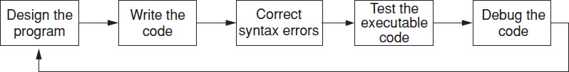
2.1 Designing a Program (2 of 7)
The purpose of Programming Logic and Design is to focus on Flow charts and Pseudocode.
The design is the foundation of a good program.
Figure 2-1 The program development cycle

Slide 5
2.1 Designing a Program (3 of 7)
Two steps in designing a program
Understand the tasks that the program is to perform.
Learning what the customer wants.
Determine the steps that must be taken to perform the task.
Create an algorithm, or step-by-step directions to solve the problem.
Use flow charts and/or pseudocode to solve.

Slide 6
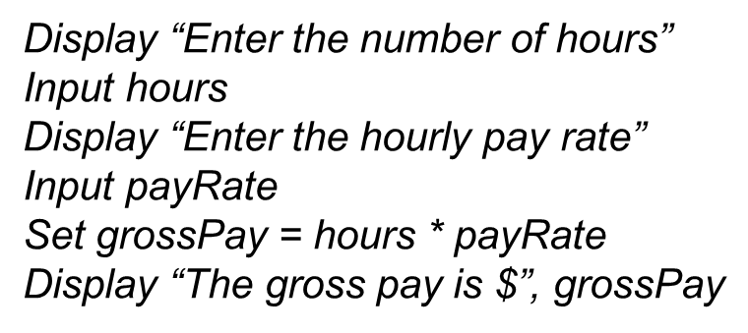
2.1 Designing a Program (4 of 7)
Pseudocode
Fake code used as a model for programs
No syntax rules
Well written pseudocode can be easily translated to actual code

Slide 7
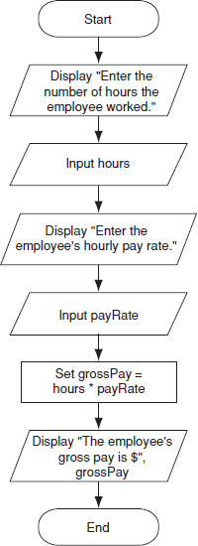
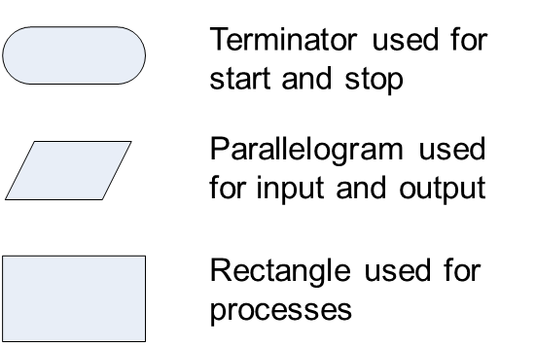
2.1 Designing a Program (5 of 7)
Flow charts
A diagram that graphically depicts the steps that take place in a program
Figure 2.2 Flow chart for the pay calculating program

Slide 8
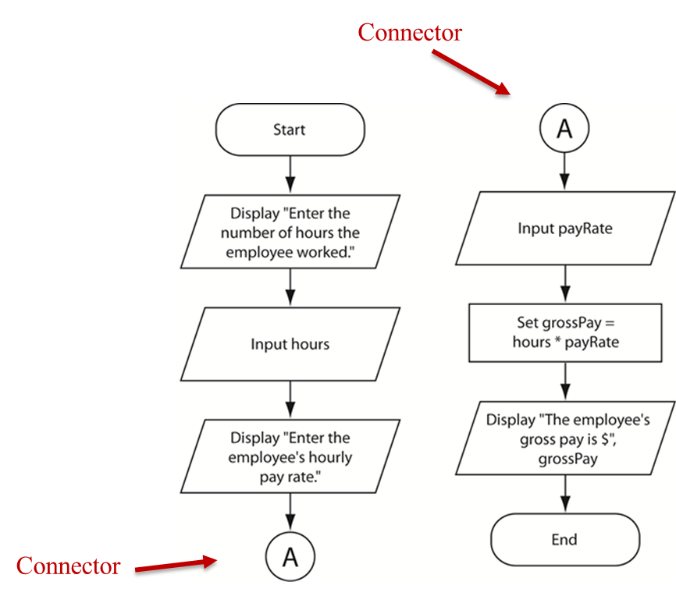
2.1 Designing a Program (6 of 7)
Flow chart Connector Symbol
Use connectors to break a flow chart into two or more smaller flow charts, and placing them side-by-side on the page.

Slide 9
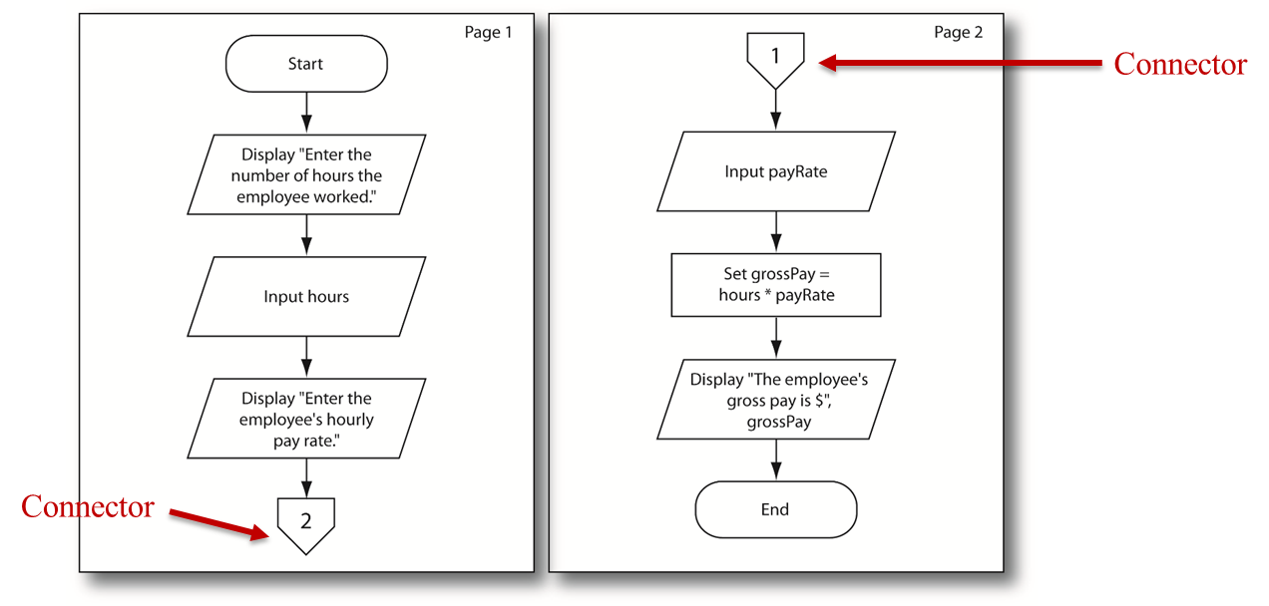
2.1 Designing a Program (7 of 7)
Off-Page Connector Symbol
To connect flow charts on different pages

Slide 10
2.2 Output, Input, and Variables (1 of 6)
Output – data that is generated and displayed
Input – data that a program receives
Variables – storage locations in memory for data
Computer programs typically follow 3 steps
Input is received
Some process is performed on the input
Output is produced

Slide 11
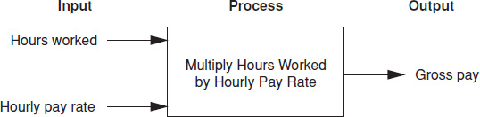
2.2 Output, Input, and Variables (2 of 6)
Input, Processing, and Output of a Pay Calculating program:

Slide 12
2.2 Output, Input, and Variables (3 of 6)
I P O Chart: Describes the input, processing, and output of a program.
Example:
I P O Chart for the Pay Calculating Program
Input | Processing | Output
Number of hours worked Hourly pay rate | Multiply the number of hours worked by the hourly pay rate. The result is the gross pay. | Gross pay

Slide 13
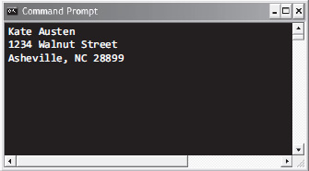
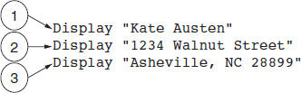
2.2 Output, Input, and Variables (4 of 6)
Display is the keyword to show output to the screen
Sequence – lines execute in the order they appear
String Literals – a sequence of characters
Figure 2-7 The statements execute in order
Figure 2-8 Output of Program 2-1

Slide 14
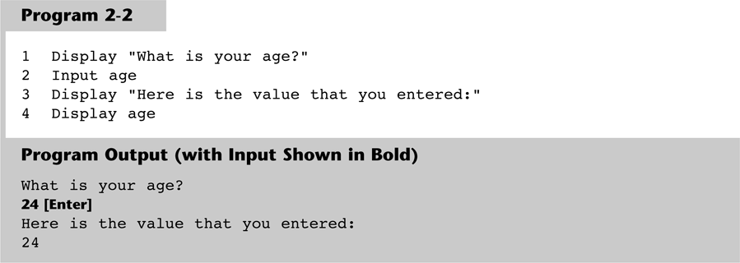
2.2 Output, Input, and Variables (5 of 6)
Input is the keyword to take values from the user of the program
It is usually stored in variables

Slide 15
2.2 Output, Input, and Variables (6 of 6)
Programmers can define variable names following certain rules
Must be one word, no spaces
Generally, punctuation characters are avoided
Generally, the first character cannot be a number
Name a variable something that indicates what may be stored in it
camelCase is popular naming convention

Slide 16
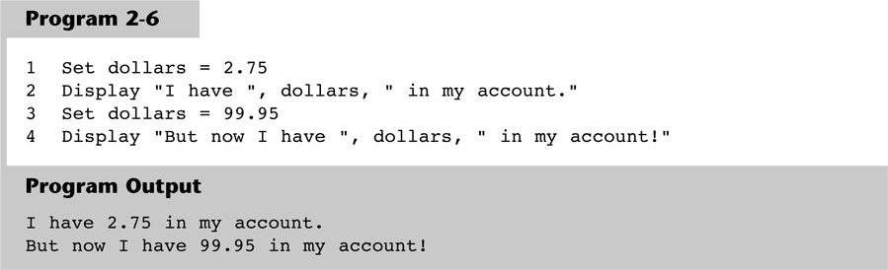
2.3 Variable Assignment & Calculations (1 of 2)
Variable assignment does not always have to come from user input, it can also be set through an assignment statement
Set price = 20

Slide 17
2.3 Variable Assignment & Calculations (2 of 2)
Calculations are performed using math operators
The expression is normally stored in variables
Set sale = price – discount
Table 2-1 Common math operators
Symbol | Operator | Description
+ | Addition | Adds two numbers
− | Subtraction | Subtracts one number from another
Asterisk | Multiplication | Multiplies one number by another
/ | Division | Divides one number by another and gives the quotient
MOD | Modulus | Divides one number by another and gives the remainder
Caret | Exponent | Raises a number to a power

Slide 18
2.4 Variable Declarations & Data Types (1 of 2)
A variable declaration includes a variable’s name and a variable’s data type
Data Type – defines the type of data you intend to store in a variable
Integer – stores only whole numbers
Real – stores whole or decimal numbers
String – any series of characters
Declare Real grossPay

Slide 19
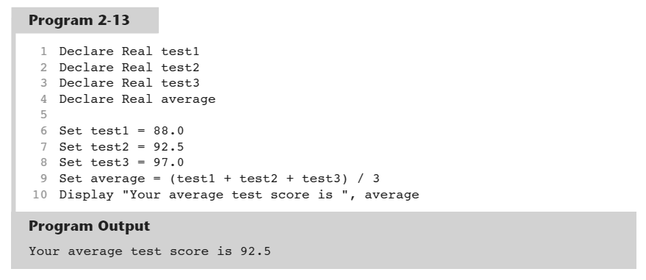
2.4 Variable Declarations & Data Types (2 of 2)
For safety and to avoid logic errors, variables should be initialized to 0 or some other value

Slide 20
2.5 Named Constants
A named constant is a name that represents a value that cannot be changed
Makes programs more self explanatory
If a change to the value occurs, it only has to be modified in one place
Constant Real INTEREST_RATE = 0.069

Slide 21
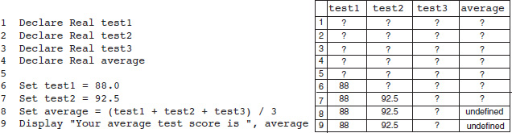
2.6 Hand Tracing a Program
Hand tracing is a simple debugging process for locating hard to find errors in a program
Involves creating a chart with a column for each variable, and a row for each line of code
Figure 2-18 Program with the hand trace chart completed

Slide 22
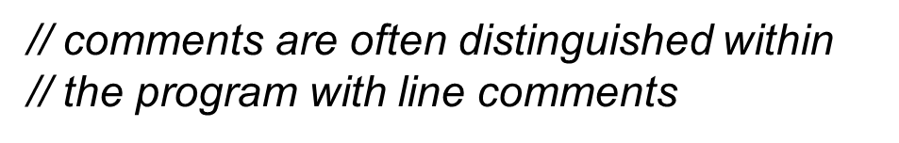
2.7 Documenting a Program
External documentation describes aspects of the program for the user, sometimes written by a technical writer
Internal documentation explains how parts of the program works for the programmer, also known as comments

Slide 23
2.8 Designing Your First Program (1 of 5)
Calculate the batting average for any player
Determine what is required for each phase of the program:
What must be read as input?
What will be done with the input?
What will be the output?

Slide 24
2.8 Designing Your First Program (2 of 5)
Input is received.
The number of hits
The number of times at bat
Some process is performed on the input.
Calculate the batting average
Divide the number of hits by the number of times at bat
Output is produced.
The player’s batting average

Slide 25
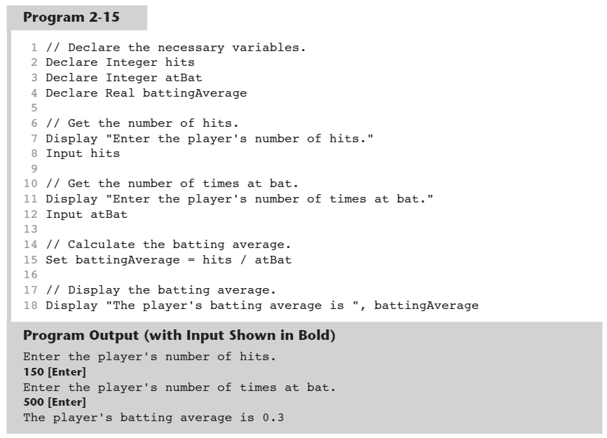
2.8 Designing Your First Program (3 of 5)

Slide 26
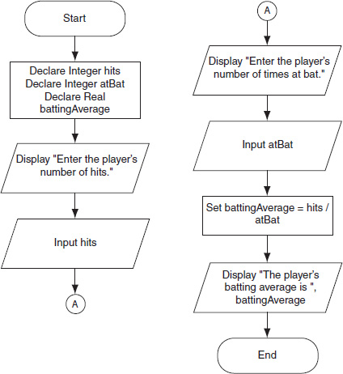
2.8 Designing Your First Program (4 of 5)
Figure 2-20 Flow chart for program 2-15

Slide 27
2.8 Designing Your First Program (5 of 5)
Summary
Input
Determine data needed for input
Choose variables to store the input
Process
Determine calculations to be performed
Choose variables to store the calculations
Output
Determine what output the program will display
Usually the results of the program’s calculations

Slide 28
2.9 Focus on Languages: Java

Slide 29
2.9 Focus on Languages: Java (1 of 11)
Setting up a Java Program
Class Name
public class Simple { public static void main(String[] args) { } }
Class Header
main Method

Slide 30
2.9 Focus on Languages: Java (2 of 11)
Displaying Screen Output
System.out.println() Displays a line of output, then advances the output cursor to the next line.
public class Output
{
public static void main(String[] args)
{
System.out.println("My major is Computer Science.");
System.out.println("I plan to be a software developer.");
System.out.println("Programming is fun!");
}
}
Program Output
My major is Computer Science.
I plan to be a software developer.
Programming is fun!

Slide 31
2.9 Focus on Languages: Java (3 of 11)
Displaying Screen Output
System.out.print() Displays output, but does not advance the output cursor to the next line.
public class Output2
{
public static void main(String[] args)
{
System.out.print("Programming");
System.out.print("is");
System.out.print("fun!");
}
}
Program Output
Programmingisfun!

Slide 32
2.9 Focus on Languages: Java (4 of 11)
Variable Declarations (see the rules for variable names on page 76 of your book)
int speed;
double distance;
String name;
Data Type | What It Can Hold
byte | Integers in the range of –128 to +127
short | Integers in the range of –32,768 to +32,767
int | Integers in the range of –2,147,483,648 to +2,147,483,647
long | Integers in the range of –9,223,372,036,854,775,808 to +9,223,372,036,854,775,807
float | Floating-point numbers in the range of ±3.4×10^{–38} to ±3.4×10³⁸ , with 7 digits of accuracy
double | Floating-point numbers in the range of ±1.7×10^{–308} to ±1.7×10³⁰⁸, with 15 digits of accuracy
String | Strings of text.

Slide 33
2.9 Focus on Languages: Java (4 of 11)
Variable Declarations (see the rules for variable names on page 76 of your book)
int speed;
double distance;
String name;
Data Type | What It Can Hold
byte | Integers in the range of -128 to +128
short | Integers in the range of -32,768 to +32,767
int | Integers in the range of -2,147,483,648 to +2,147,483,647
long | Integers in the range of –9,223,372,036,854,775,808 to +9,223,372,036,854,775,807
float | Floating-point numbers in the range of ±3.4 * 10⁻³⁸ to ±3.4 * 10³⁸, with 7 digits of accuracy
double | Floating-point numbers in the range of ±1.7 * 10⁻³⁰⁸ to ±1.7 * 10³⁰⁸, with 15 digits of accuracy
String | Strings of text

Slide 34
2.9 Focus on Languages: Java (5 of 11)
Reading Keyboard Input (reading an integer)
import java.util.Scanner;
public class GetAge
{
public static void main(String[] args)
{
Scanner keyboard = new Scanner(System.in);
int age;
System.out.println("What is your age?");
age = keyboard.nextInt();
System.out.println("Here is the value that you entered:");
System.out.println(age);
}
}
Create a Scanner object
Read an integer
Program Output
What is your age? 24 [Enter] Here is the value that you entered:
24

Slide 35
2.9 Focus on Languages: Java (6 of 11)
Reading Keyboard Input (reading a real number)
import java.util.Scanner;
public class GetAge
{
public static void main(String[] args)
{
Scanner keyboard = new Scanner(System.in);
double temp;
System.out.println("What is the temperature?");
temp = keyboard.nextDouble();
System.out.println("Here is the value that you entered:");
System.out.println(temp);
}
}
Create a Scanner object
Read a double
Program Output
What is the temperature? 74.5 [Enter] Here is the value that you entered:
74.5

Slide 36
2.9 Focus on Languages: Java (7 of 11)
Reading Keyboard Input (reading a string)
import java.util.Scanner;
public class GetAge
{
public static void main(String[] args)
{
Scanner keyboard = new Scanner(System.in);
String name;
System.out.println("What is your name?");
name = keyboard.nextLine();
System.out.println("Here is the value that you entered:");
System.out.println(name);
}
}
Create a Scanner object
Read a String
Program Output
What is your name? Jimmy [Enter] Here is the value that you entered:
Jimmy

Slide 37
2.9 Focus on Languages: Java (8 of 11)
Displaying Multiple Items with the + Operator
Example:
System.out.println("This is " + "one string.");
This statement will display:
This is one string.
Example:
number = 5;
System.out.println("The value is " + number);
This code will display:
The value is 5

Slide 38
2.9 Focus on Languages: Java (9 of 11)
Performing Calculations – Operators + Addition - Subtraction * Multiplication / Division % Modulus
Examples:
total = price + tax;
sale = price - discount;
population = population * 2;
half = number / 2;
leftOver = 17 % 3;

Slide 39
2.9 Focus on Languages: Java (10 of 11)
Named constants – use the final key word in declarations: final double INTEREST_RATE = 0.069; This declares a double constant named INTEREST_RATE, set to the value 0.069.

Slide 40
2.9 Focus on Languages: Java (11 of 11)
Documenting a program with comments // This is a line comment /* This is a multiline comment. */

Slide 41
2.9 Focus on Languages: Python

Slide 42
2.9 Focus on Languages: Python (1 of 8)
Displaying Screen Output
print() function Displays a line of output, then advances the output cursor to the next line.
print('My major is Computer Science.');
print('I plan to be a software developer.');
print('Programming is fun!');
Program Output
My major is Computer Science.
I plan to be a software developer.
Programming is fun!

Slide 43
2.9 Focus on Languages: Python (2 of 8)
You do not declare variables in Python.
Instead, you use an assignment statement to create a variable.
See the rules for variable names on page 81 of your book.
age = 25 title = 'Vice President'

Slide 44
2.9 Focus on Languages: Python (3 of 8)
Pass multiple arguments to the print function, and Python will print each argument's value on the screen, separated by a space.
age = 25
print('I am', age, 'years old.');
Program Output
I am 25 years old.

Slide 45
2.9 Focus on Languages: Python (4 of 8)
Reading Keyboard Input (reading a string)
first_name = input('Enter your first name: ')
last_name = input('Enter your last name: ')
print('Hello', first_name, last_name)
Program Output
Enter your first name: Vinny [Enter]
Enter your last name: Brown [Enter]
Hello Vinny Brown

Slide 46
2.9 Focus on Languages: Python (5 of 8)
Reading Keyboard Input (reading an integer)
hours = int(input('How many hours did you work? '))
print('Here is the value that you entered:', hours)
Program Output
How many hours did you work? 40 [Enter] Here is the value that you entered: 40

Slide 47
2.9 Focus on Languages: Python (6 of 8)
Reading Keyboard Input (reading a real number)
pay_rate = float(input('What is your hourly pay rate? '))
print('Here is the value that you entered:', pay_rate)
Program Output
What is your hourly pay rate? 20 [Enter] Here is the value that you entered: 20

Slide 48
2.9 Focus on Languages: Python (7 of 8)
Performing Calculations – Operators + Addition - Subtraction * Multiplication / Division % Modulus ** Exponent
Examples:
total = price + tax
sale = price - discount
population = population * 2
half = number / 2
leftOver = 17 % 3
result = 4**2

Slide 49
2.9 Focus on Languages: Python (8 of 8)
Documenting a program with comments # This is a comment

Slide 50
2.9 Focus on Languages: C++

Slide 51
2.9 Focus on Languages: C++ (1 of 11)
The typical C++ program contains the following code:
#include <iostream>
using namespace std;
int main()
{
return 0;
}
You will write statements that appear in this area.

Slide 52
2.9 Focus on Languages: C++ (2 of 11)
Displaying Screen Output with the cout Statement
Begins with the word cout
followed by the << operator
followed by an item of data that is to be displayed.
The statement ends with a semicolon.
#include <iostream>
using namespace std;
int main()
{
cout << "Hello world";
return 0;
}
Program Output
Hello world

Slide 53
2.9 Focus on Languages: C++ (3 of 11)
#include <iostream>
using namespace std;
int main()
{
cout << "Hello world";
return 0;
}
#include <iostream>
using namespace std;
int main()
{
cout << "Hello " << "world";
return 0;
}
Program Output
Hello world
Program Output
Hello world
#include <iostream>
using namespace std;
int main()
{
cout << "Hello ";
cout << "world";
return 0;
}
#include <iostream>
using namespace std;
int main()
{
cout << "Hello" << endl;
cout << "world" << endl;
return 0;
}
Program Output
Hello world
Program Output
Hello
world

Slide 54
2.9 Focus on Languages: C++ (4 of 11)
Variable Declarations (see the rules for variable names on page 87 of your book)
int speed;
double distance;
string name;
Data Type | What It Can Hold
short | Integers in the range of -32,768 to +32,767
int | Integers in the range of -2,147,483,648 to +2,147,483,647
long | Integers in the range of -2,147,483,648 to +2,147,483,647
float | Floating-point numbers in the range of ±3.4 * 10⁻³⁸ to ±3.4 * 10³⁸, with 7 digits of accuracy
double | Floating-point numbers in the range of ±1.7 * 10⁻³⁰⁸ to ±1.7 * 10³⁰⁸, with 15 digits of accuracy
char | Can store integers in the range of -128 to +127. Typically used to store characters.
string | Strings of text
bool | Stores the values true or false

Slide 55
2.9 Focus on Languages: C++ (5 of 11)
Reading Keyboard Input (reading an integer)
#include <iostream>
using namespace std;
int main()
{
int age;
cout << "What is your age?" << endl;
cin >> age;
cout << "Here is the value that you entered:" << endl;
cout << age;
return 0;
}
Read a value into the age variable
Program Output
What is your age? 24 [Enter] Here is the value that you entered:
24

Slide 56
#include <iostream>
#include <string>
using namespace std;
int main()
{
string name;
double payRate;
int hours;
cout << "Enter your first name." << endl;
cin >> name;
cout << "Enter your hourly pay rate." << endl;
cin >> payRate;
cout << "Enter the number of hours worked." << endl;
cin >> hours;
cout << "Here are the values that you entered:" << endl;
cout << name << endl;
cout << payRate << endl;
cout << hours << endl;
return 0;
}
Program Output
Enter your first name.
Connie [Enter] Enter your hourly pay rate.
55.25 [Enter]
Enter the number of hours worked.
40 [Enter]
Here are the values that you entered:
Connie
55.25
40

Slide 57
2.9 Focus on Languages: C++ (7 of 11)
Using getline To Read String Input Containing Spaces
#include <iostream>
#include <string>
using namespace std;
int main()
{
string name;
cout << "Please enter your name." << endl;
getline(cin, name);
cout << "Hello, " << name << endl;
return 0;
}
Program Output
Please enter your name.
Kate Smith [Enter]
Hello, Kate Smith

Slide 58
2.9 Focus on Languages: C++ (8 of 11)
Performing Calculations – Operators + Addition - Subtraction * Multiplication / Division % Modulus
Examples:
total = price + tax;
sale = price - discount;
population = population * 2;
half = number / 2;
leftOver = 17 % 3;

Slide 59
2.9 Focus on Languages: C++ (9 of 11)
Named constants – use the const key word in declarations: const double INTEREST_RATE = 0.069; This declares a double constant named INTEREST_RATE, set to the value 0.069.

Slide 60
2.9 Focus on Languages: C++ (10 of 11)
Documenting a program with comments // This is a line comment /* This is a multiline comment. */

Slide 61

Copyright

